Slide 1
Hand Gesture Controlled Bot
Day - 3

Slide 2
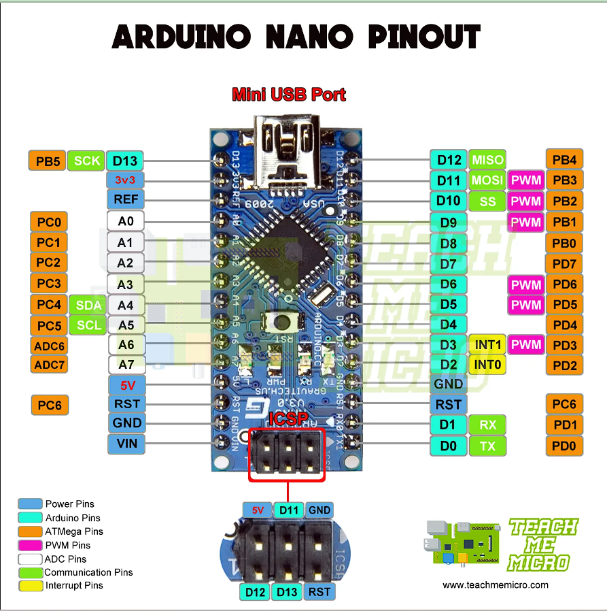

Slide 3
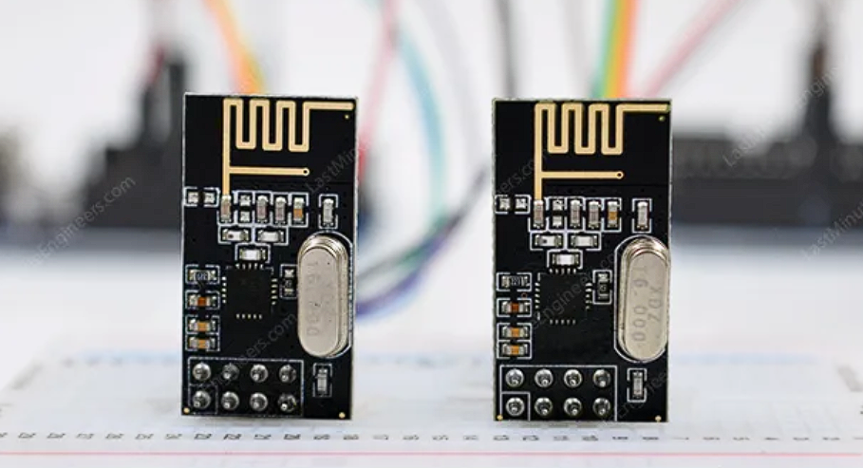
nRF24L01

Slide 4
Introduction:
NRF24L01 is basically a wireless transceiver, which is used to send and receive data by using radio waves. It is a single chip transceiver module. It uses SPI protocol for transmitting data. Its data transmission speed is up to 2Mbps. NRF24L01 is normally used in industrial devices and projects for data transmission. It is mostly used in computer, toys, remote control, games, and other electronic devices.

Slide 5
Key Features:
NRF24L01 is a wireless transceiver module (works on SPI Protocol), which is used for sending and receiving data at an operating radio frequency of 2.4 to 2.5 GHz ISM(Industrial,Scientific,Mdeical) band.
This transceiver module consists of a frequency generator,power amplifier, crystal oscillator modulator, and demodulator.
This module is designed for long distance and fast transmission of data.

Slide 6
It is designed to work through an SPI protocol.
Air data transmission rate of NRF24L01 is around 2 Mbps.
It is designed to work through an SPI protocol.
Air data transmission rate of NRF24L01 is around 2 Mbps.
This module is designed to operate at 3.3 volts.
This module has an address range of 125 and it can communicate with six other modules. There is main eight pinouts of NRF24L01 but it also has some additional pins.

Slide 7
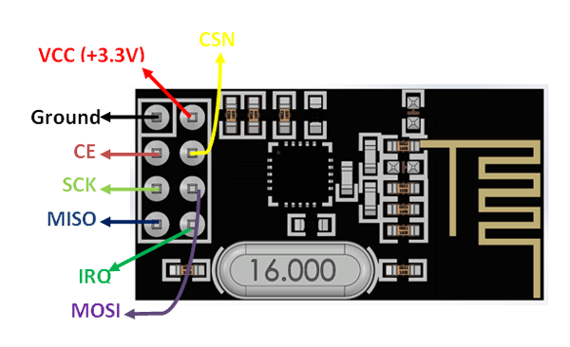
nRF24L01 Pinout

Slide 8
Pin Name | Abbreviation | Function
GND | Ground | Connected to the Ground of the system.
Vcc | Power | Powers the module using 3.3V.
CE | Chip Enable | Used to enable SPI communication.
CSN | Chip Select Not | This pin has to be kept high always,else it will disable the SPI communication.
SCK | Serial Clock | Provides Clock using which SPI communication works.
MOSI | Master Out Slave In | Connected to MOSI pin of MCU, for the module to receive data from MCU.
MISO | Master In Slave Out | Connected to MISO pin of MCU, for the module to send data from MCU.
IRQ | Interrupt | It is active low pin and used only if interrupt is required.

Slide 9
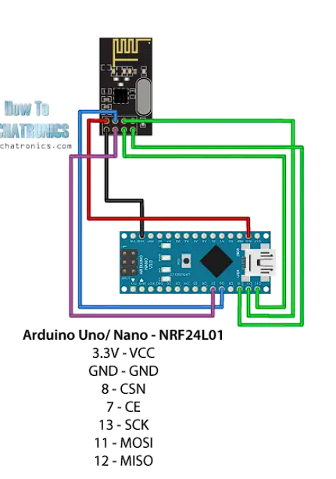
Transmitter Side Connection:

Slide 10
Receiver Side Connection:

Slide 11
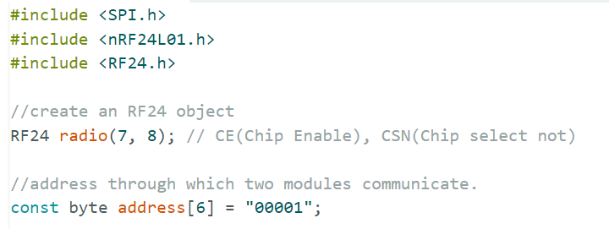
Transmitter Code:

Slide 12
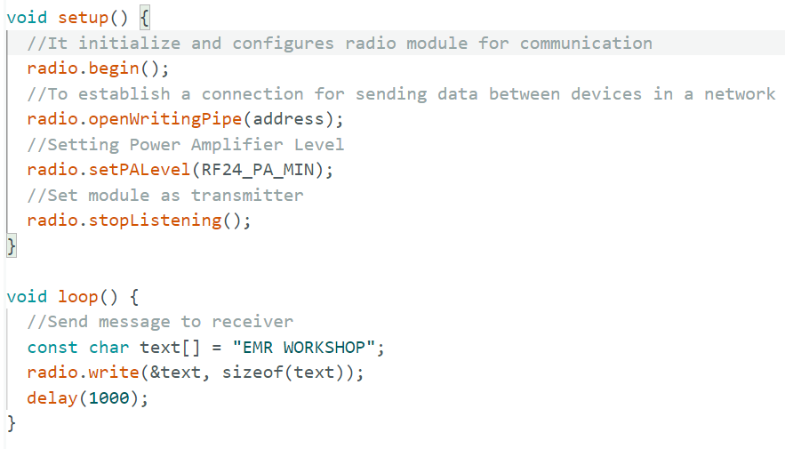

Slide 13
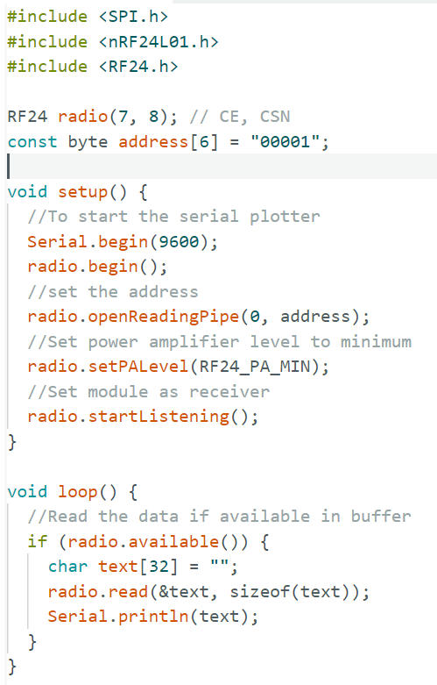
Receiver Code:

Slide 14
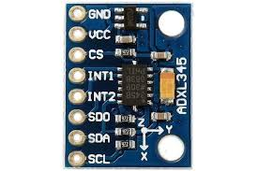
ADXL345
Accelerometer
Sensor

Slide 15
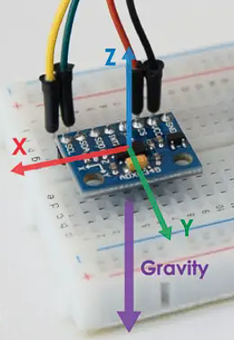
Introduction:
The ADXL345 is a popular accelerometer sensor designed and manufactured by Analog Devices. It is a small, thin, low-power, 3-axis accelerometer that provides accurate and reliable acceleration measurements in various applications. The sensor is widely used in consumer electronics, industrial systems, robotics, and other applications where measuring acceleration is crucial.

Slide 16
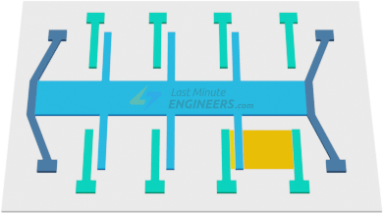
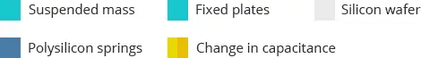
Working:
A MEMS (Micro-Electro-Mechanical System) accelerometer is a micro-machined structure built on top of a silicon wafer.

Slide 17
This structure is suspended by polysilicon springs. It allows the structure to deflect when accelerated along the X, Y, and/or Z axes.
As a result of deflection, the capacitance between fixed plates and plates attached to the suspended structure changes. This change in capacitance is proportional to the acceleration along that axis.
The sensor processes this change in capacitance and converts it into an analog output voltage.

Slide 18
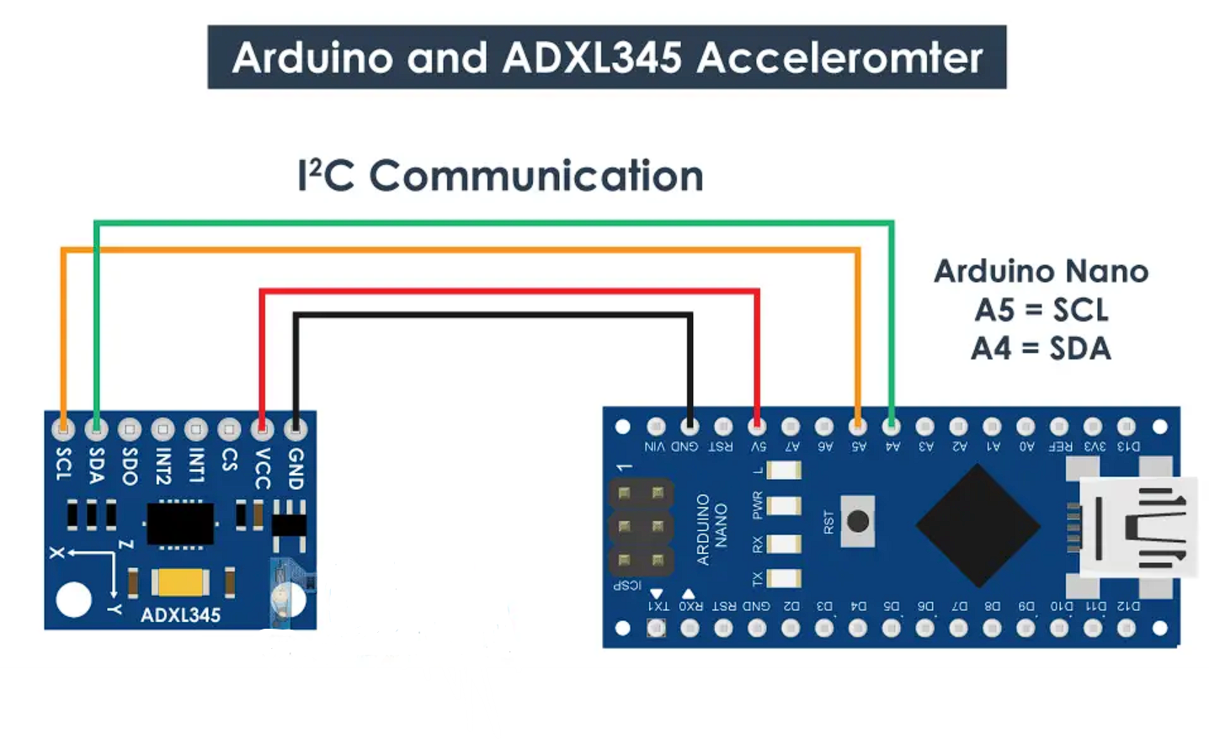
Connections with Arduino Nano:

Slide 19
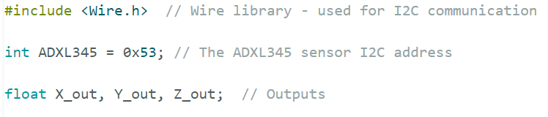
ADXL345 Accelerometer Arduino Nano Code

Slide 20
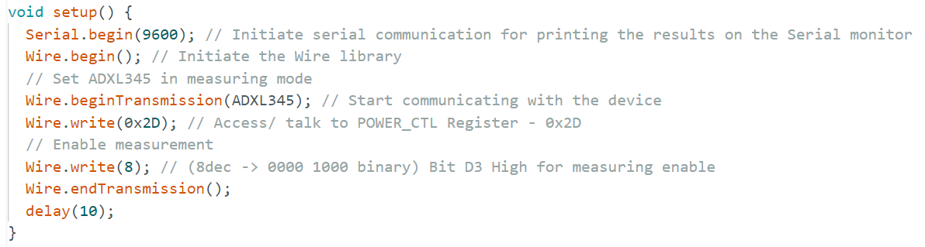

Slide 21
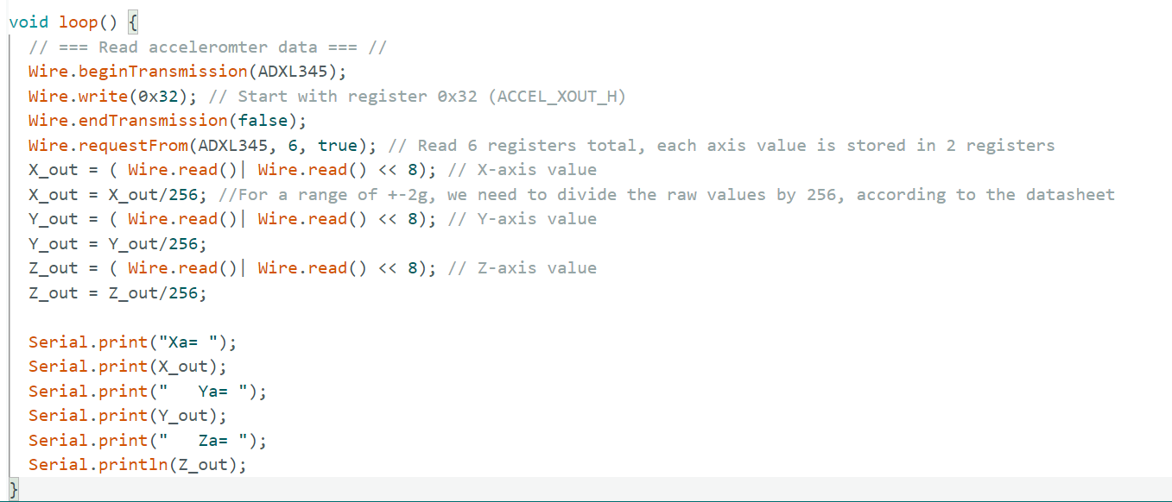

Slide 22
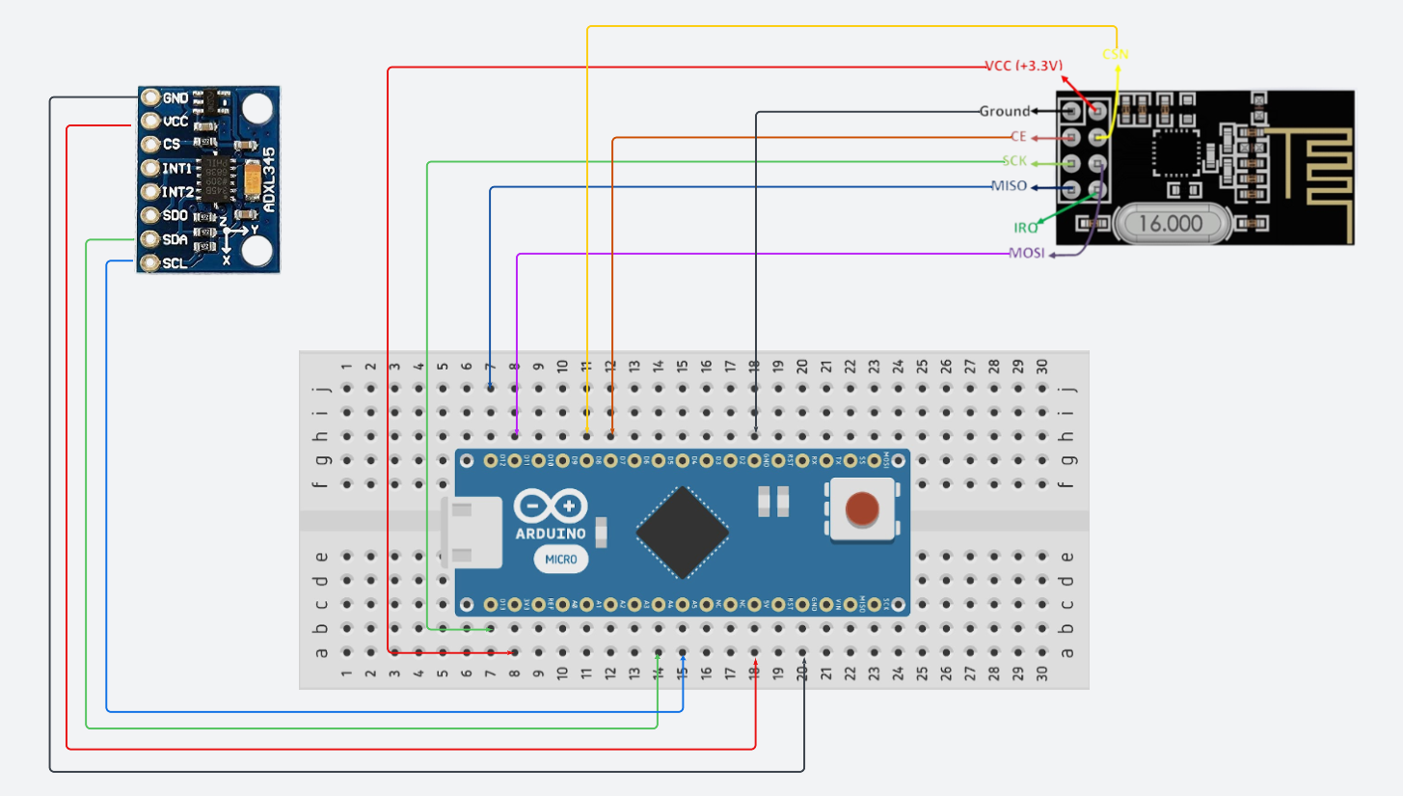
Transmitter Circuit Diagram:

Slide 23
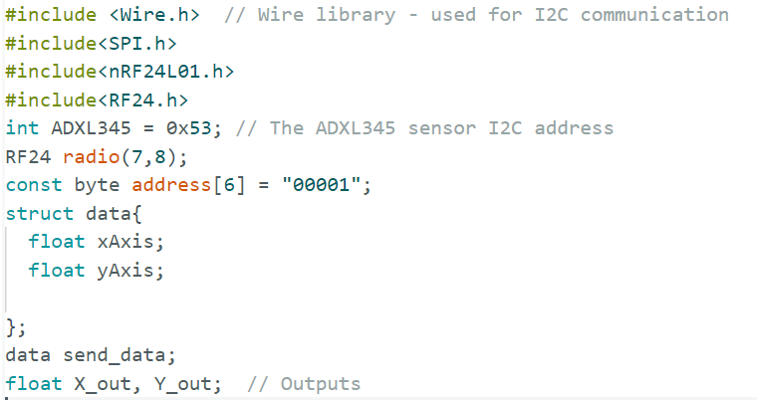
Transmitter Code:

Slide 24
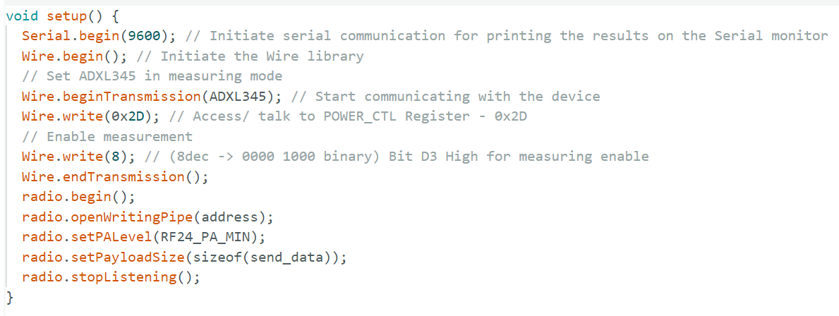

Slide 25
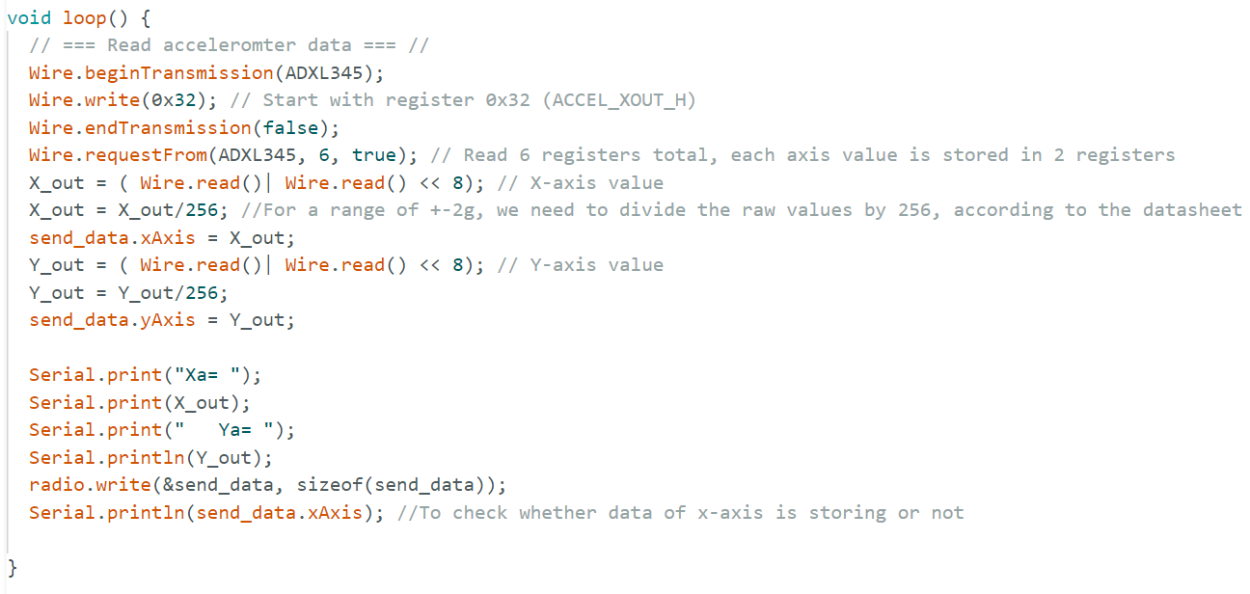

Slide 26
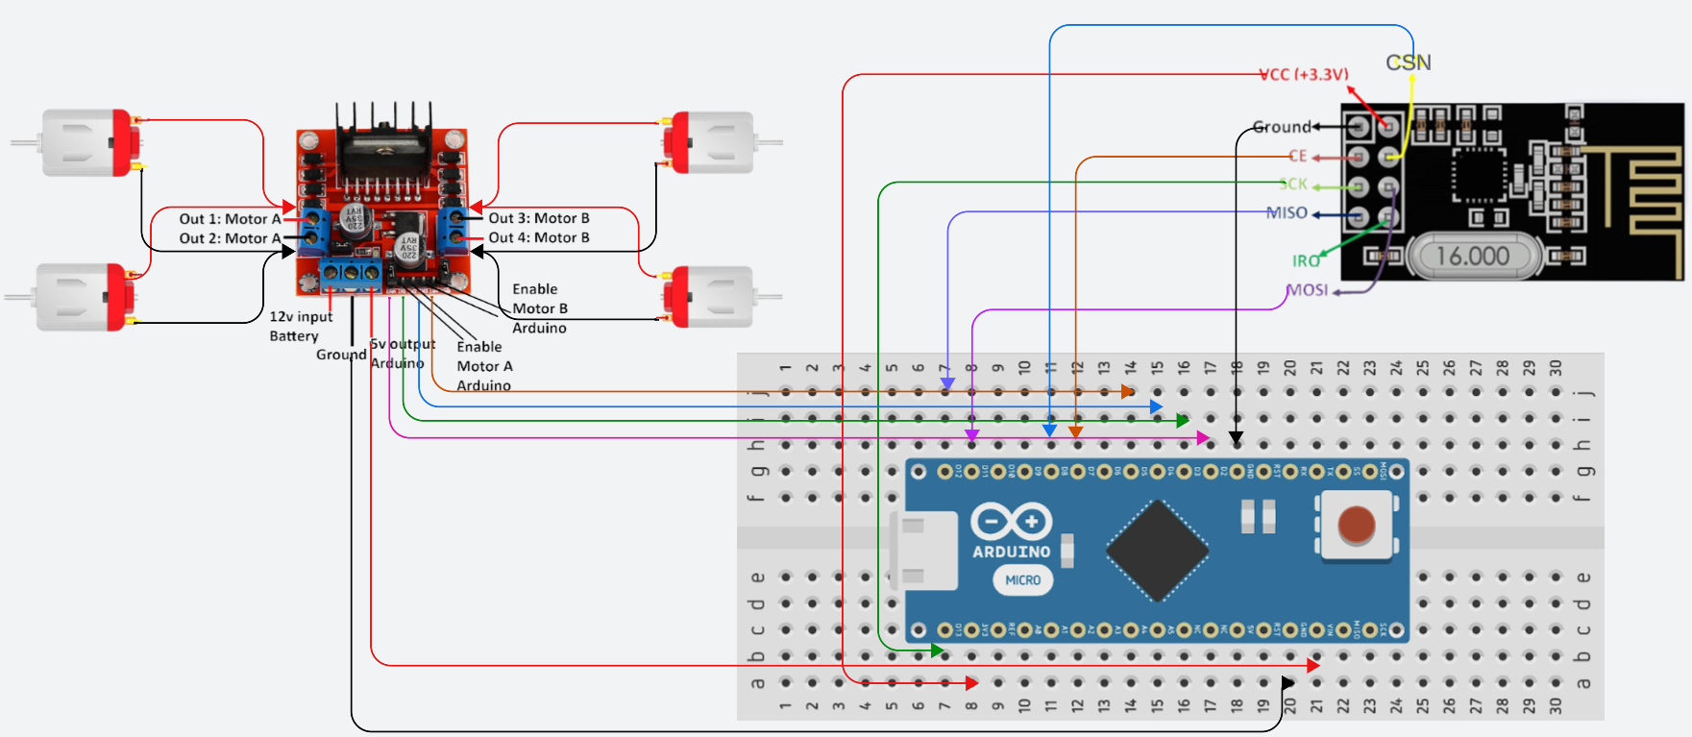
Receiver Circuit Diagram:

Slide 27
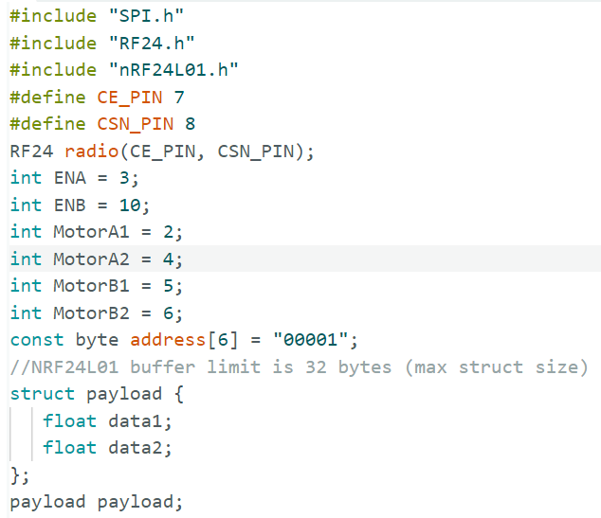
Receiver Code:

Slide 28
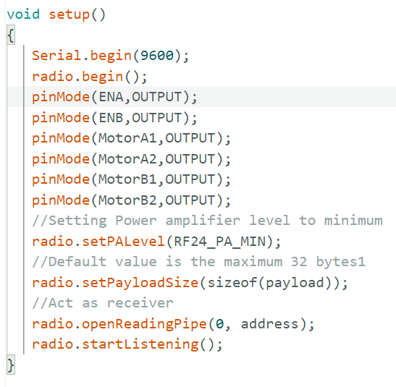

Slide 29
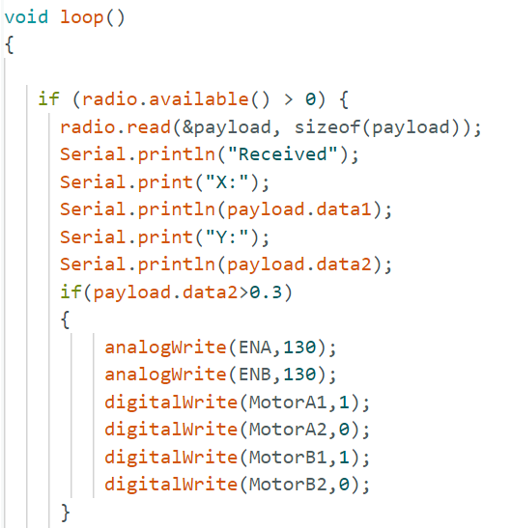

Slide 30
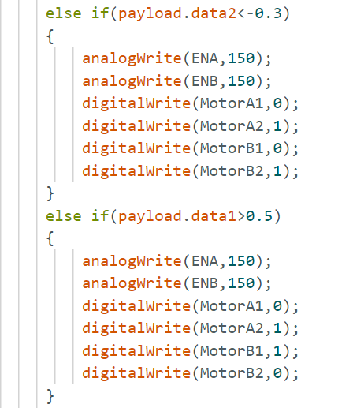

Slide 31
